Slide 1

Welcome
TO
OUR Presentation

Slide 2
Course Title:-Emergence of Bangladesh. Course Code :- GEN-226 Course Instructor :- Prof.Gazi Mahabubul Alam PhD,FRSA.

Slide 3
2018
-------
1975
1971
1970
Nawab-ism
1969
Colonial or Royal-ism
1966
East and West Pakistan
1952
1947
-----
1857
1757
1756
1733
1700
Bangladesh
1672
1633
1612

Slide 4


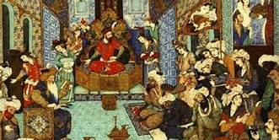

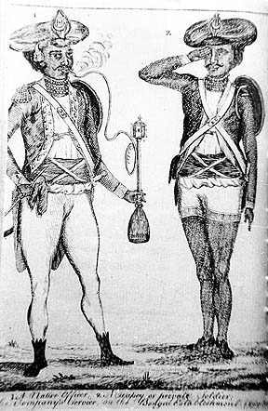
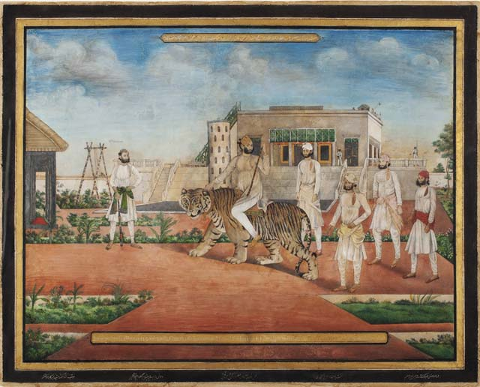
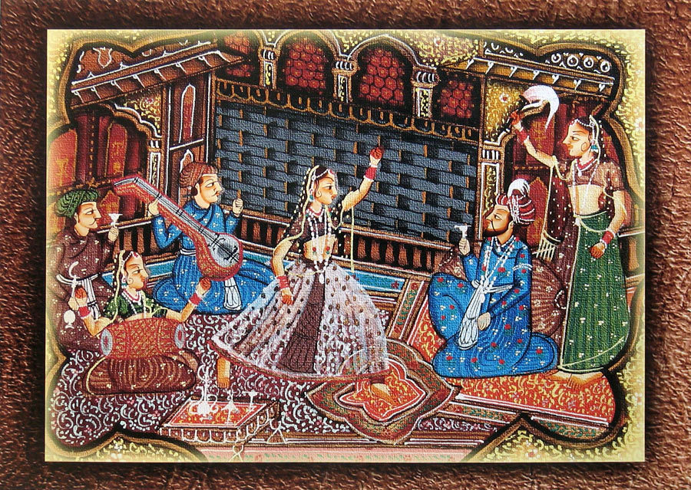
Nawab-ism

Slide 5
Merit | De-Merit
Nature based economy | Hypocrisy and fraudulence
Architectural Reforms | Injustice to the people
Education | Adultery
Structured administrative process | Collect VAT forceable.

Slide 6



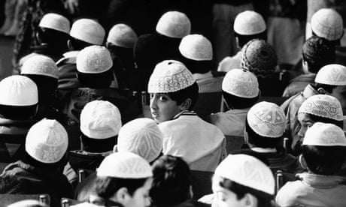
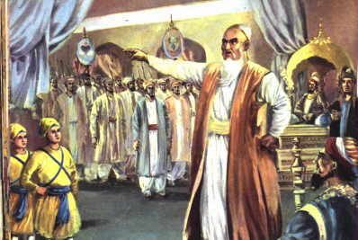

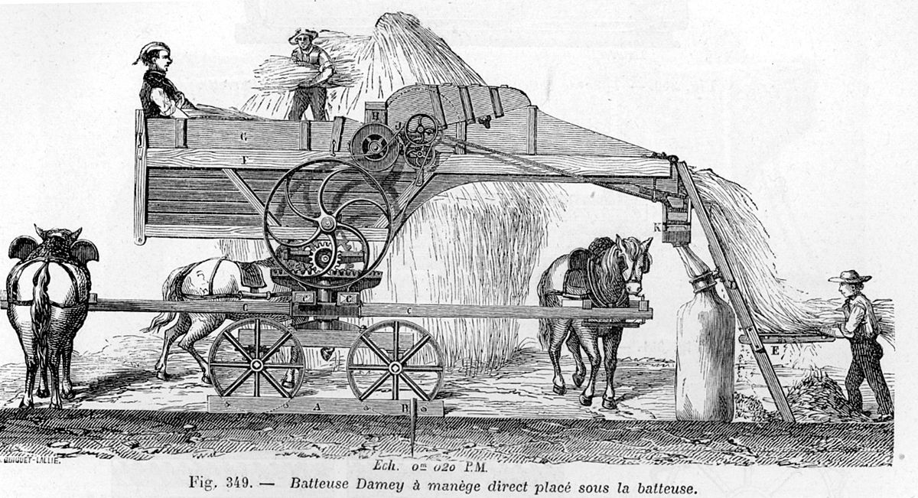
Merit

Slide 7

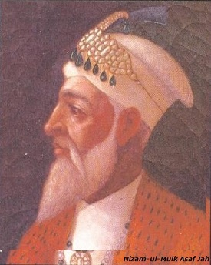
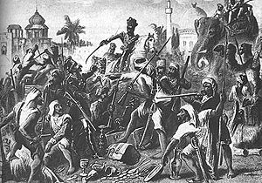

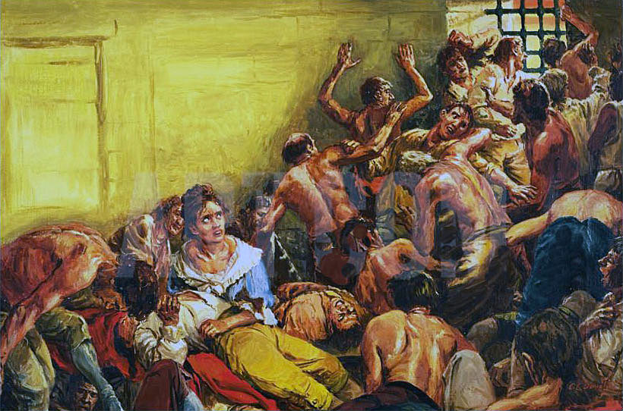
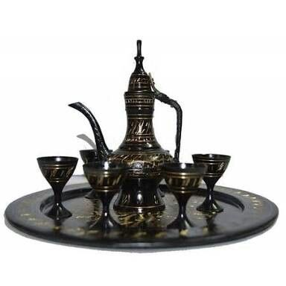
De-Merit

Slide 8

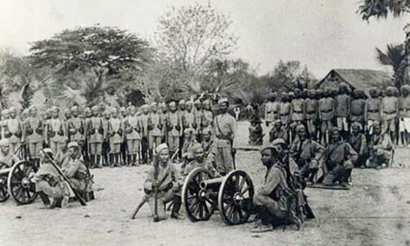
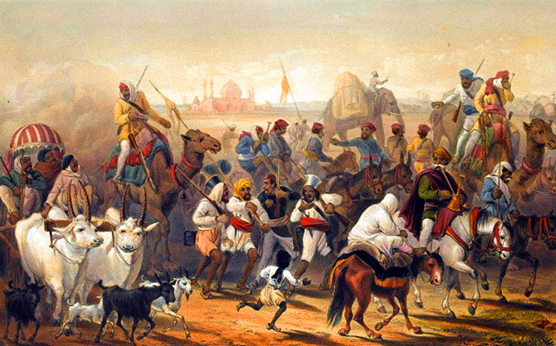
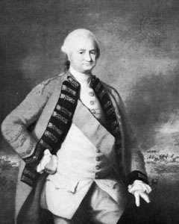

Royalism

Slide 9
Merit | De-Merit
Educational Reform | No economic growth
Social Reform | High taxation
Transport system develop | Forcing farmers to plant indigo.
Monuments and Heritage Sites | Denied proper rights in every sector.

Slide 10


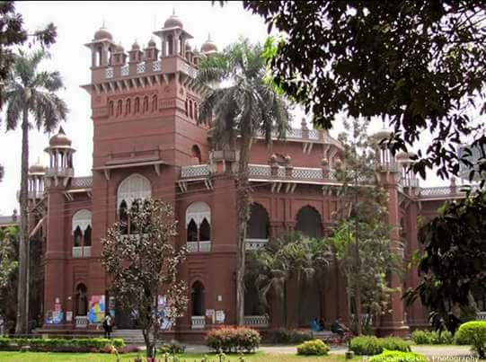
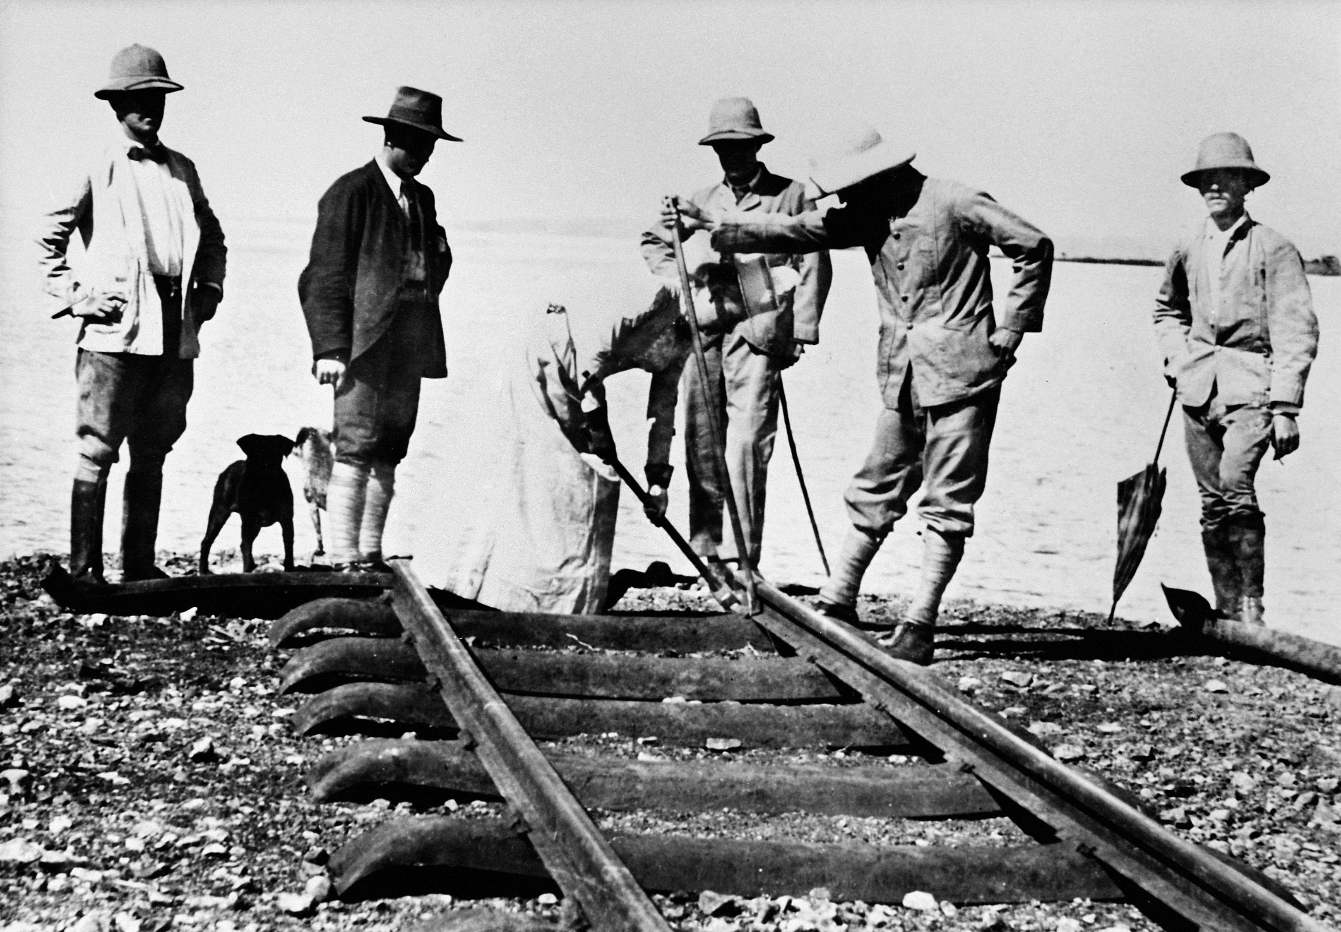
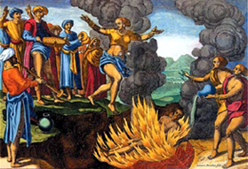
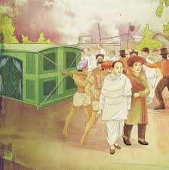

Merit

Slide 11



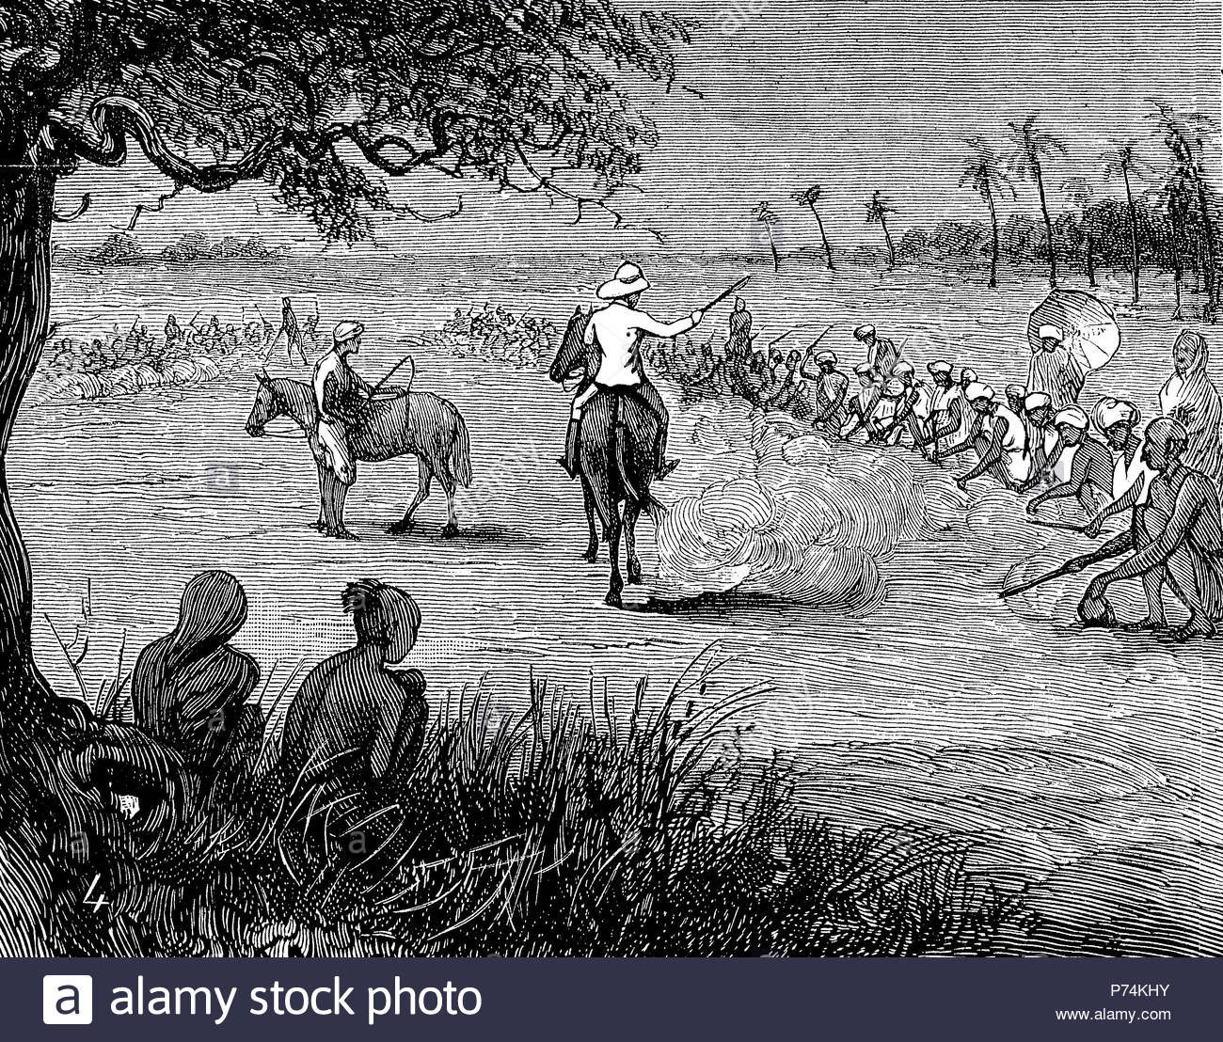
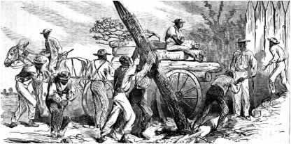
De-Merit

Slide 12

81%
Please go to next slide……

Slide 13


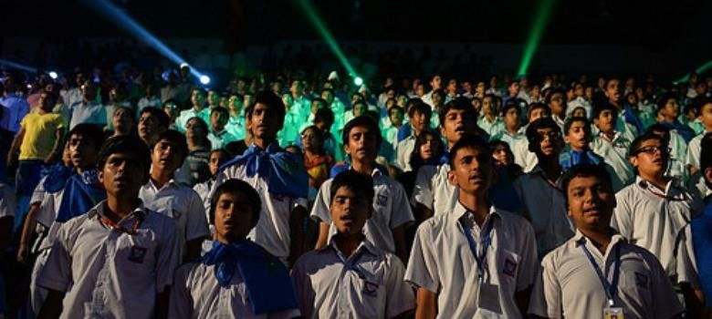
Racism
*What is racism? *Types
*How came?
*Naming Reasons.

Slide 14

Economics
Product
Service
Type of economic sectors:-
i)Micro
ii)Macro
Structure ratio of economic sectors:-
i)Product
ii)Services.

Slide 15



Independent and Independence
What is independent ?
What is independence?
Types of independence
i)Micro
ii)Macro

Slide 16

Leadership
Victoria Family Ideology + train base
Nawab-era Ideology base
Pre-Bangladesh Ideology base
Post-Bangladesh Follower base
Leadership’s variety ?
Settled leadership ?

Slide 17
নেতৃত্ব
দর্শনযুক্ত
দর্শনছাড়া
মাইক্রো
ম্যাক্রো
Nawab-era,
Colonial-era,
Pre-Bangladesh
Post-Bangladesh

Slide 18
Leadership
Charismatic Leadership
Configental Leadership
Shajahan,
Shahid Kokon
Akber,
Shekikh-Mujib
State of Organ
State Leader
People

Slide 19

ANY QUESTION ???

Slide 20




